Slide 1
Introduction to Computer Networks
Types of Networks

Slide 2
Different types of network
A computer network can be divided into the following types, based on the geographical areas they cover, functionality, ownership, and communication media used.
LAN(Local Area Network)
WAN(Wide Area Network)

Slide 3
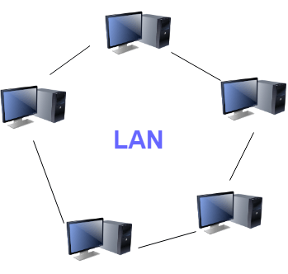
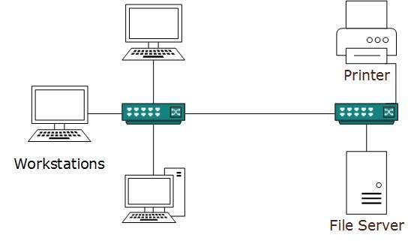
Local area network (LAN)
It is used to connect two or more personal computers through a communication medium such as coaxial, twisted-pair cables, etc.
Examples of LAN are networking in a home, school, library, laboratory, college, office, etc.

Slide 4
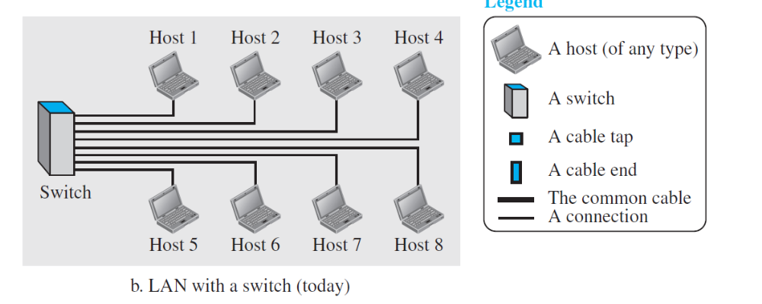
Local area network (LAN)
LANs use a smart connecting switch, which is able to recognize the destination address of the packet and guide the packet to its destination without sending it to all other hosts.

Slide 5
When to use a LAN:
If you have many users needing to connect at a single location.
When devices and resources need to communicate directly with one another within a small geographic area.
Systems connected in a small network like in a building or a small office
It is inexpensive

Slide 6
Wide Area Network (WAN)
A LAN interconnects hosts; a WAN interconnects connecting devices such as switches, routers, or modems
WAN is also an interconnection of devices capable of communication.
WAN has a wider geographical span, spanning a town, a state, a country, or even the world

Slide 7
Wide Area Network (WAN)
A LAN is normally privately owned by the organization that uses it;
a WAN is normally created and run by communication companies and leased by an organization that uses it
1.<number>

Slide 8
Types of WAN
point-to-point WANs and
switched WANs
1.<number>

Slide 9
Point-to-Point WAN
It is a network that connects two communicating devices through a transmission media (cable or air).
1.<number>

Slide 10
Switched WAN
A switched WAN is a network with more than two ends.
It is used in the backbone of global communication.
switched WAN is a combination of several point-to-point WANs that are connected by switches.
1.<number>

Slide 11

An isolated LAN connecting 12 computers to a hub in a closet
Notes:
1.#

Slide 12

WANs: a switched WAN and a point-to-point WAN
1.<number>
Notes:
1.#

Slide 13

A heterogeneous network made of four WANs and two LANs
Notes:
1.#

Slide 14
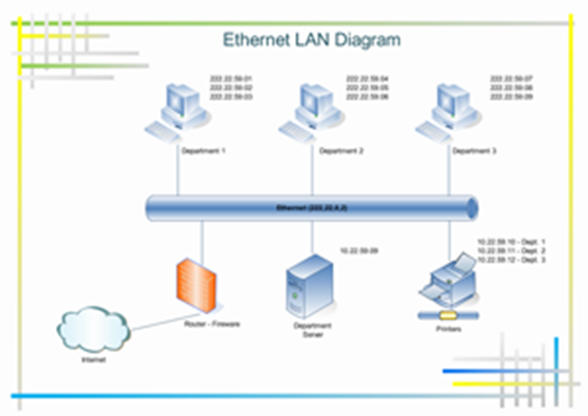
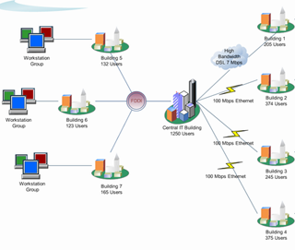

Slide 15
Internetwork or internet.
When two or more networks are connected, they make an internetwork, or internet
To make the communication between employees at different offices possible, the management leases a point-to-point dedicated WAN from a service provider, such as a telephone company, and connects the two LANs.
Now the company has an internetwork, or a private internet (with lowercase i).

Slide 16
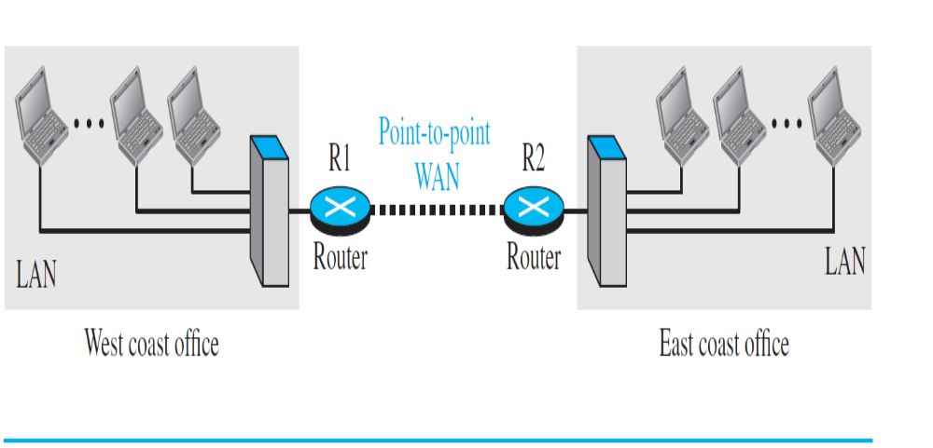
An internetwork made of two LANs and one point-to-point WAN

Slide 17
Switching or switched network
An internet is a switched network in which a switch connects at least two links together.
A switch needs to forward data from a network to another network when required.
The two most common types of switched networks are circuit-switched and packet-switched networks

Slide 18
Types of switched networks
circuit-switched and
packet-switched networks.
1.<number>

Slide 19
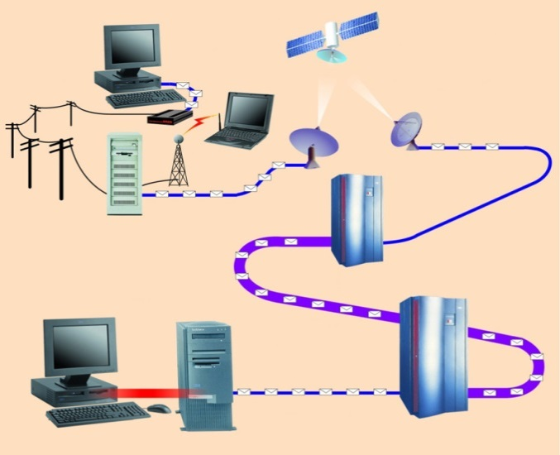
Communication Channels
A channel is a path between two communication devices
Channel capacity: How much data can be passed through the channel (bit/sec)
  Also called channel bandwidth
  The smaller the pipe the slower data transfer!
Consists of one or more transmission media
  Materials carrying the signal
  Two types:
    Physical: wire cable
    Wireless: Air
T1 lines
T1 lines
destination network server
T3 lines
T1 lines

Slide 20
Bandwidth & Throughput
Bandwidth is the maximum amount of data that can travel through a 'channel'.
Throughput is how much data actually does travel through the 'channel' successfully.
channel is the number of bits it can transfer per second
1.<number>
Notes:
1.#

Slide 21
delay
The delay of a network specifies how long it takes for a bit of data to travel across the network from one node or endpoint to another.
It is typically measured in multiples or fractions of seconds.
1.<number>

Slide 22
1-4 PROTOCOLS
It consists of a set of rules that govern data communications.
It determines
what is communicated,
how it is communicated and
when it is communicated.
The key elements of a protocol are
syntax,
semantics and
timing
1.<number>
Notes:
1.#

Slide 23
_x0010_Elements of a Protocol
Syntax
  Structure or format of the data
  Indicates how to read the bits - field delineation
Semantics
  the meaning of each section of bits
  Knows which fields define what action
Timing
  When data should be sent and what
  Speed at which data should be sent or speed at which it is being received.
1.<number>
Notes:
1.#

Slide 24
Standards
Creating and maintaining an open and competitive market for equipment
To provide guidelines to manufacturer , vendors and government agencies
Two categories:
1. De facto – not approved by an
organized body but adopted
2. De jure – officially recognized
1.<number>

Slide 25
Standards organizations
ISO – International organization for
standardization
ITU-T – International Telecommunication
union
ANSI
IEEE
EIA
1.<number>

Slide 26
Internet
Network is a group of connected communicating devices
internet- two or more networks that can communicate with each other.
Internet – a collaboration of more than hundreds of thousands of interconnected networks
ARPA – Advanced Research Projects Agency
1.<number>

Slide 27

Figure 1.13 Hierarchical organization of the Internet
ISP – internet
connection use
service
1.<number>
Notes:
1.#

Slide 28
Internet Connections
Internet backbone A set of high-speed networks that carry Internet traffic
These networks are provided by companies such as AT&T, GTE, and IBM
Internet service provider (ISP) A company that provides other companies or individuals with access to the Internet
15-<number>

Slide 29
Internet Connections
There are various technologies available that you can use to connect a home computer to the Internet
  A phone modem converts computer data into an analog audio signal for transfer over a telephone line, and then a modem at the destination converts it back again into data
  A digital subscriber line (DSL) uses regular copper phone lines to transfer digital data to and from the phone company’s central office
  A cable modem uses the same line that your cable TV signals come in on to transfer the data back and forth
15-<number>

Slide 30
Internet Connections
Broadband A connection in which transfer speeds are faster than 128 bits per second
  DSL connections and cable modems are broadband connections
  The speed for downloads (getting data from the Internet to your home computer) may not be the same as uploads (sending data from your home computer to the Internet)
15-<number>

Slide 31
Networking
The generic term node or host refers to any device on a network
Data transfer rate The speed with which data is moved from one place on a network to another
Data transfer rate is a key issue in computer networks
15-<number>

Slide 32
Understanding the Data Rate Units
Unit | Symbol | Description
bits per second | bps or b/s or bit/s
Kilobits per second | Kbps or kb/s or kbit/s | 1 Kbps = 1,000 bps
Megabits per second | Mbps or Mb/s or Mbit/s | 1 Mbps = 1,000 Kbps
Gigabits per second | Gbps or Gb/s or Gbit/s | 1 Gbps = 1,000 Mbps
Terabits per second | Tbps or Tb/s or Tbit/s | 1 Tbps = 1,000 Gbps
Petabits per second | Pbps or Pb/s or Pbit/s | 1 Pbps = 1,000 Tbps
Bytes per second | Bps or B/s | 1 Bps = 8 bps
Kilobytes per second | KBps or KB/s | 1 KBps = 1,000 Bps
Megabytes per second | MBps or MB/s | 1 MBps = 1,000 KBps
Gigabytes per second | GBps or GB/s | 1 GBps = 1,000 MBps
Terabytes per second | TBps or TB/s | 1 TBps = 1,000 GBps
Petabytes per second | PBps or PB/s | 1 PBps = 1,000 TBps
1.<number>

Slide 33
1 KB | 1 KiloByte | (1 KB = 1,024 Bytes = 8,192 bits ) [1 Byte = 8 bits. 1,024 Bytes = 1 KiloByte (1 KB); therefore 1 KB is 8,192 bits ( 1*1,024 Bytes*8 = 8,192 ).]
1 kb | 1 kilobit | (1 kilobit = 1,000 bits)
1 MB | 1 MegaByte (filesize) | (1 MegaByte = 1,048,576 Bytes = 1,024 KiloBytes)
1 mb | 1 megabit | (1 megbit = 1,000,000 bits [one million bits] = 1,000 kb) [4]
1 mbps or 1 Mbps | (bitrate) | "1 million bits per second", or "1 megabit every second".
1 GB | 1 GigaByte | (1,073,741,824 Bytes) [*4] (also used: "gig").
1 BB | 1 billion Bytes | (1,000,000,000 Bytes) "BB" is an alternative to "GB" for base-10; hard drives and DVDs say "GB" when the values are actually in BB [*1]
1 KB/s |  | "The ratio of one KiloByte to one second." i.e. "One KiloByte per second."
1 kbps |  | "One kilobit per second."
Bytes → big "B"; bits → small "b".
When talking about storage, think Bytes, not bits.
When talking about data transfer, use bits, not Bytes.

Slide 34
Applications and layered architectures
Various services: various applications require various services
Flexibility: powerful networks need to be flexible enough to support the current services and future services
Architectures: an overall network architecture is necessary to achieve the flexibility

Slide 35
Layered architectures
Layers: grouping the common functions
Benefits of layers:
  Simplicity: easy to design once layers and their interaction are defined clearly
  Flexibility: easy to modify and develop networks by separate layers modifications
  Incremental changes: add new layers, add new functions to a layer

Slide 36
Three obvious tasks (layers)
Transport of data across the network from one end to the other
Routing/forwarding of packets across multiple hops
Transfer of a frame from one interface to another (i.e., one hop).

Slide 37
Big picture of layered architectures
Web browsing and e-mail examples
OSI reference model (Seven layers)
TCP/IP architecture
Detailed end-to-end examples to complete big picture of layered architectures
Socket API and other utilities

Slide 38
Terminology
Client/Server model: the most typical interaction between two parties within networks
Client: the process making requests
Server (Daemon): the process waiting and receiving requests, processing the requests and returning results
Protocols: a set of rules governing how two communicating parties are to interact.
Service: a protocol will provide a service
Layers’ protocols: each layer carries out a specific set of functions using its own protocol, and builds on the services of the layer below it (provides a service to its upper layer).

